Slide 1
Vectors
Some of the quantities we measure in our daily lives are completely determined by their magnitudes, for example, length, mass, area, temperature, and energy. We call such quantities scalar quantities.
Quantities such as displacement, velocity, acceleration, and other forces that have magnitude as well as direction are called vector quantities.

Slide 2
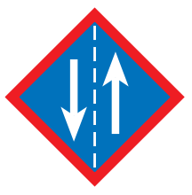


Directed line segment
A directed line segment in the plane is called a vector
Two vectors that have the same direction and length are called equal vectors.

Slide 3
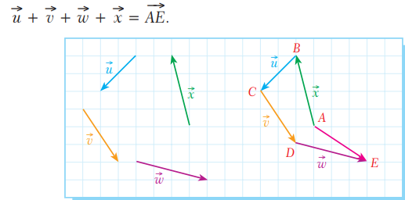
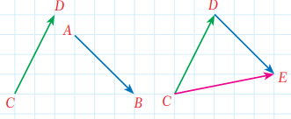
Addition of Vectors
The Polygon Method

Slide 4
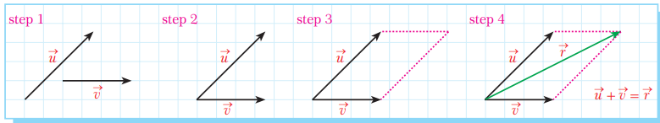
The Parallelogram Method

Slide 5

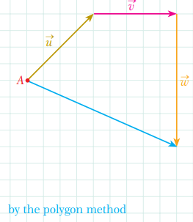
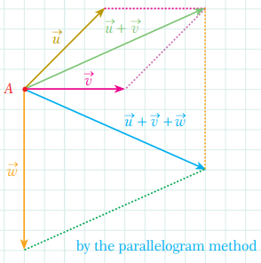
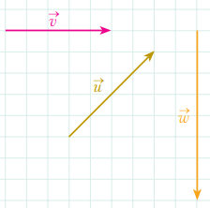
Example

Slide 6
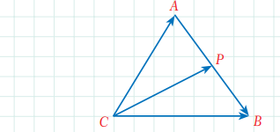
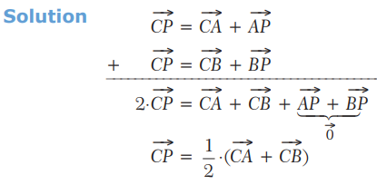
Example 2

Slide 7

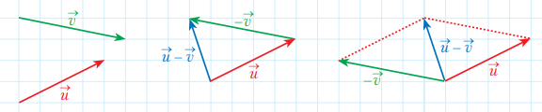
Subtraction of Vectors

Slide 8
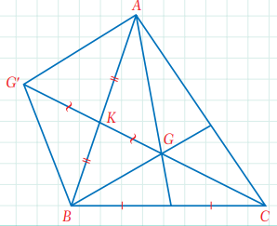
Example 3

Slide 9
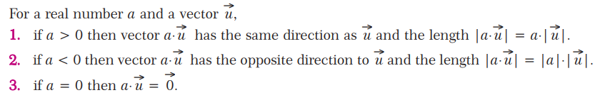
Multiplication of a Vector by a Scalar

Slide 10


Example 4

Slide 11
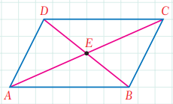
Parallel Vectors
Example 5
Prove that the diagonals of a parallelogram intersect at their midpoints by using vectors.

Slide 12
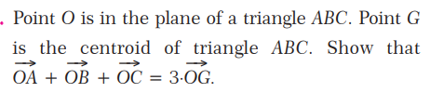

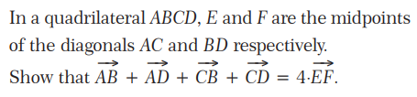
Practice

Slide 13

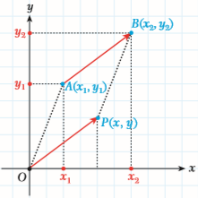


Position Vector

Slide 14
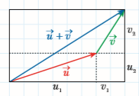

Addition of Vectors

Slide 15
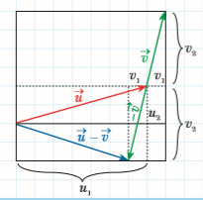

Subtraction of Vectors

Slide 16

Multiplication of a Vector by a Scalar

Slide 17
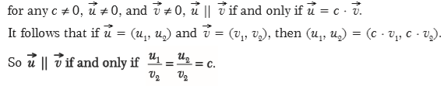
Parallel Vectors

Slide 18
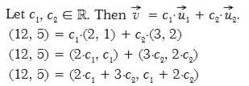


Linear Combination of Vectors ( optional)

Slide 19

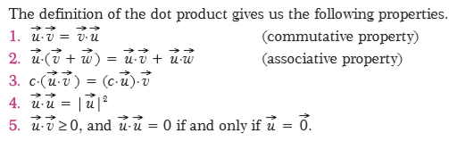
DOT PRODUCT (Scalar Product)

Slide 20

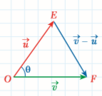
Angle Between Two Vectors
Prove by using the law of cosines.

Slide 21

Perpendicular and Parallel Vectors

Slide 22
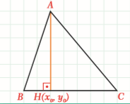
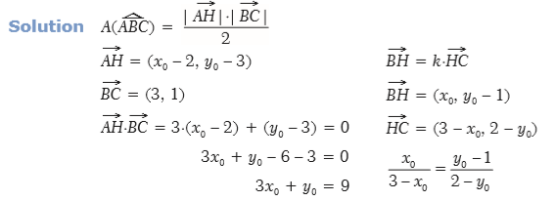

Example 6

Slide 23




Practice 2

Slide 24
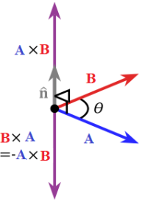

Vector ( cross) product
n is the unit vector at right angles to both a and b

Slide 25
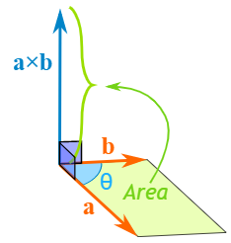
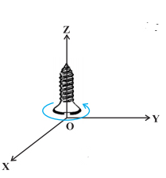
The magnitude of the cross product equals the area of a parallelogram with vectors a and b for sides:
Direction of the cross product is determined
By “ Right Hand Rule”.

Slide 26
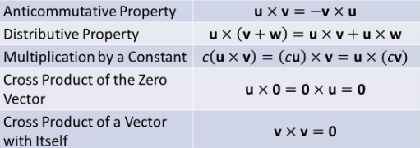
PROPERTIES of Cross Product

Slide 27
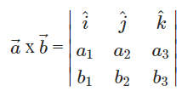
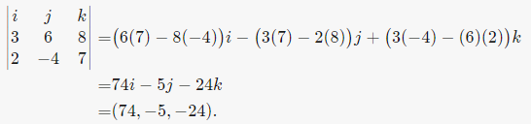
Component Form of Vector Product
Example 7

Slide 28
Practice 3
Calculate the area of the triangle.

Slide 29
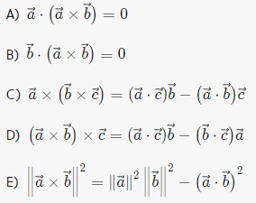
PROPERTIES That Relate The Cross Product And The Dot Product

Slide 30
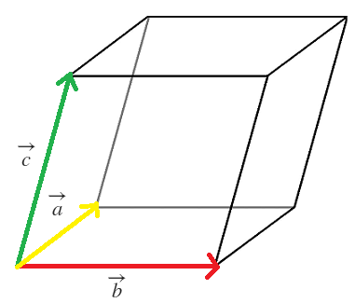


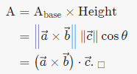
Example 8

